Slide 1



MEMBERS QUESTIONS
Go to
pigeonhole.at
Enter passcode
YEXD52

Slide 2

Annual General Meeting
April 11th 2024

Slide 3
THIS EVENING’S AGENDA….
7.00pm Welcome & Introduction
7.10pm Treasurers Report
7.25pm Aircraft review
7.35pm CFI Review
7.55pm Safety review
8.10pm Airfield Review
8.20pm Equipment Status Review
8.30pm Airfield Review
8.45pm Election of 2024 Committee
8.50pm Questions from members and Pigeonhole
9.00pm Closing remarks and briefing for year ahead
9.10pm Meeting Close

Slide 4
CHAIRMAN
Apologies
Chairman’s report
Year in review
Notes:
Apologies
It has been great to see the up tick in flying and attendance at the field after the extended slow down of flying operations. Whilst not the best year we have had for flying hours, certainly a great year for soaring and getting new people into our sport.
Inflation and the cost of living have become salient issues of our time, with far-reaching implications for households and businesses alike. As a consequence, our operations have not been spared, and we anticipate continued challenges in the foreseeable future. However, we are fortunate to possess a measure of "inflation immunity," owing to the fact that much of our "labour" is provided on a volunteer basis. In this vein, I extend my deepest gratitude to those who continuously and generously donate their time and expertise to perform a wide range of tasks throughout the club, some of which are more conspicuous than others. Indeed, the preparation and upkeep of the airfield, aircraft, winches, workshop, and clubhouse are all essential components that contribute to the success of our endeavors, and without a maintenance program we would be unable to fulfil our mission. Moreover, there are many other critical tasks that are performed "behind the scenes," often from the comfort of one's home. Although the fruits of these labours may not be immediately visible, their impact is felt throughout the club, and without them our members would undoubtedly suffer.
Like numerous other clubs and organizations, we are facing mounting difficulties in enlisting volunteers to perform essential duties for preserving the quality of our facilities and services. While I empathize with and acknowledge the causes of this issue, I remain hopeful that we can reverse this trend. Nevertheless, we must prepare for the prospect of outsourcing some of these responsibilities to contractors in the future, which will undoubtedly incur financial expenses. In light of these developments, we have a straightforward equation to consider: either we must secure more volunteers for these tasks, or we must devise strategies to augment our revenue streams to offset the inescapable costs.
The committee has been very conscious of membership costs and flying fees and has worked hard to ensure what income we do have is spent wisely and efficiently. However we must face the fact that our expenses are getting higher and our income is frozen, so with this in mind we must expect something to give soon and some tough decisions will need to be made. More open days, more corporate and scout events, more advertising are all in order in the effort to keep our costs from spiralling. We also need to manage replacement aircraft and winches.
Updating the online content of the membership platform and flight logging automation itself turned out to be more of a challenge than expected and I must apologise for the delay in solving the problems, but hopefully we are nearly there and aim to have it functioning very soon.
The economic challenges ahead will be testing for us as a club, but as we’ve already seen during the recent ‘threats’ thrown at us by Covid and ‘land issues,’ we are well-equipped to deal with those challenges, both through good housekeeping and the great services of our volunteers
There are a lot of opportunities which can help with our retention and member engagement, and I feel we lack a level of customer service which our membership expects, and more what so new members demand. We must continue to improve our ability to convert trial lessons into full members and after this ensure that they have a clear path through to solo, Bronze and beyond.
We must adopt the upcoming club strategic plan and measure ourselves against it to be able to gauge how the club delivers a serious class of product. The club must change and adapt to the ever changing environment to remain viable, as well as being prepared for the future of gliding. It is not acceptable any more to stay still and just exist as a club as ultimately this is the path to a tragic demise, and I call on our committee to ensure that the path we beat morphs continuously with the sport environment and becomes better at developing the club into something spectacular. This is not impossible, it just needs a little focus, some tenacity, and a serious ability to make the changes necessary. The solution is already within the club and on the airfield every day we fly, we just need to have the foresight to put our hands up and roll up our sleeves and offer our skill set. This is what makes our club so great.
I hope that you, like me, remain confident about our future.

Slide 5
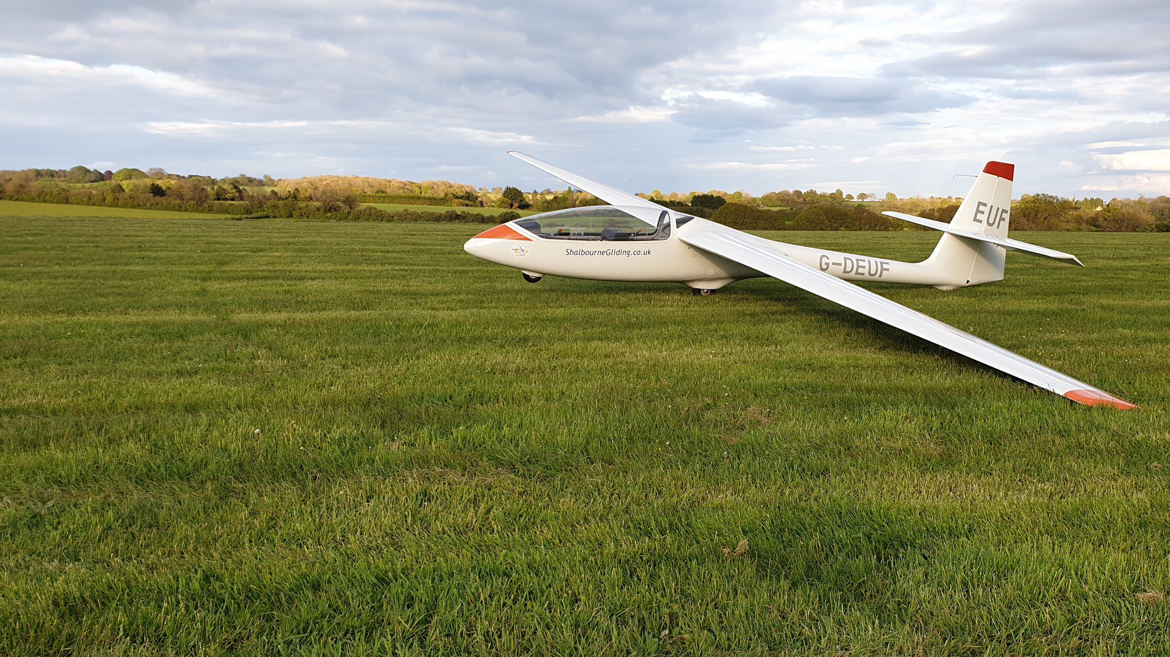
YEAR IN REVIEW……
Notes:
Talk about

Slide 6
2023 (2022)
Total Flights 2224 (2413)
Total Hours 382 (382)
Total Flight Revenue £30,703 (£33,320)
Saturday Flights 669 (788)
Wednesday Flights 697 (581)
Sunday Flights 625 (738)
Other Weekdays 246 (303)

Slide 7
Yearly Comparison - Flights

Slide 8
Yearly Comparison - Revenue

Slide 9
FINANCIAL OVERVIEW
FINANCIAL REPORT & COMPARISON
 | INCOME | EXPENDITURE
FY 2023 | £54,583 | £56,582
FY 2022 | £61,498 | £64,256
2023 we ran around £7k less in income than 2022, but we also dropped our expenses by around £8k. If we take into account the reason for the income loss (poor soaring year), we can estimate a loss of around £5k in flying fees which would have given us a surplus for FY2023 had the year been more weather friendly.
Overall, this is an acceptable result. The changes the committee made last year is starting to bear fruit. However we have many more opportunities and ways of making these figures more favourable.

Slide 10
Opportinities
Mentoring
Buddy system for new members
Open days
Advertising – talking aircraft to county shows etc.
Member retention
Club social events
New aircraft
New ground equipment
Ground school
Intensive courses
Corporate Events
Additional Weekday flying
Aerotow
Competitions
There is NO REASON WHY Shalbourne cannot be bigger and better!

Slide 11
TREASURER
ANNUAL FINANCIAL REPORT
2024 CHALLENGES
2024 FINANCIAL PLAN

Slide 12
TREASURER - Expenditure
Expense | £
Admin | £597
Aircraft | £11,341
BGA | £2,450
Club Insurance | £8,669
Corporation Tax | £1,200
Cost of Sales | £603
Fuel | £4,478
Glider Rental | £1,116
Maintenance | £1,205
Miscellaneous | £1,779
Projects | £8,614
Refunds | £1,449
Safety | £1,173
Significant extra cost has been incurred in this financial year in the aircraft budget head due to the Puchaz parts transport problems in particular and other remedial work. The generator, workshop and freeflight projects were also spend above the norm.
In the coming year we will have to continue to manage our spend tightly as part of our goal to maintain a contingency of £20,000 and to start our new financial year at the beginning of October with £36,000 or more in the kitty.
The uncertainty in the UK economy and the world for may be the next two years should make us wary of increasing our fixed costs.

Slide 13
TREASURER - Income
Income | £
Grant | £2,667
Member’s fees | £41,398
Miscellaneous | £993
Trial Lessons | £16,148
Visiting Pilots | £292
*including membership | £14,544
*including trailerage | £3,464
Objectives are to retain members, win new members, develop more activities to attract pilots from other clubs and make our day to day operations more efficient.
Make sure we meet our CASC obligations.
I am stepping down as Treasurer and want to thank Terri Cook for taking on the job.
I also want to thank Stephen Ottner and Steve Barber for their outstanding support during my Tenure.
Bob Symons

Slide 14
Aircraft officer
FLEET STATUS
MAINTENANCE EXPENSES 2022
FLEET PLANNING 2023

Slide 15
Chief flying instructor
2023 YEAR IN REVIEW
INSTRUCTOR TRAINING
CLUB EXPEDITIONS

Slide 16
CFI – Annual review
Rated instructor training will resume shortly but now with a reduced number of candidates. Training likely to be on Thursday evenings and at selected weekends if there are enough two seaters available.
As per previous year’s annual checks were supposed to be completed by the end of last month. Despite the recent poor weather, I will not be extending the end date, this is purely for safety reasons as with the limited flying opportunities so far this year many members are simply not current enough. Therefore, for those who have not completed their annual checks yet then they will need to do so before they can fly solo.
I’m still thinking of arranging a club expedition later this year probably going to a site where we can conduct aerotow training or refreshers. Let me know if you are interested and we will try to get something sorted.
During the last 12 months have not had any serious accidents or incidents at the club. I think we came close a few times, but luck, if that is the best way of putting it, was on our (or your) side. However, others in the gliding fraternity didn’t have the same luck as us. Please be mindful that things can go very wrong very quickly in aviation.
Please do not allow yourself to be distracted whilst rigging or when checking the correct connection of control surfaces. Make sure that you always enlist the help of a suitably briefed and competent person to confirm that your glider is rigged correctly and is safe to fly.
As the saying goes safety is no accident, so let’s keep it that way!

Slide 17
SAFETY OFFICER
STATEMENT FROM CHRIS BESSENT
RESIGNED MARCH 2024
Notes:
As some may know, due to sudden ill health I am forced to reevaluate my life and also due to the nature of my condition I cannot, for the present continue with my pastime and passion of gliding.
This will be the last time I will be reporting as safety Officer as well as a member of Shalbourne Gliding for now, but perhaps for much longer.
I hope I have done enough to help the club continue and grow but leave it now in capable hands.
Any role within the committee is routed in a profound desire to support the sport of gliding and specifically to make sure all members at Shalbourne continue to enjoy this fantastic sport.
It is often a thankless task as a committee member, seen by many as an unnecessary obstacle to enjoyment, but without the dedication the club would simply fold.
As members of this club I would urge all of you to do your utmost to support each other, making sure we are safe, profitable and fly. Each one of you have a special part in achieving this common goal but it cannot happen unless you go a little above and beyond the call of duty.
Each pound we save, each incident we prevent means we continue to fly and have fun.
With warm wishes to all.
Chris.

Slide 18
EQUIPMENT OFFICER
RESIGNED MARCH 2024

Slide 19
AIRFIELD OFFICER
AIRFIELD EQUIPMENT
SITE SECURITY
2023 PLANNING

Slide 20
Airfield
The past year has seen a number of improvements to the airfield , primarily to provide constant power to the workshops but also to provide a basic ( and I mean basic ) water supply and infrastructure system to the club
The new solar power system can now provide lighting and small tools support from a 3KW solar array on the south side of the hangar with a 13kw gas powered generator for overall power for the winter months.The array presently saves the club some £50 per month in the non use of gas for generation.
This will soon be supplemented with a Flarm base station installation to assist with the integration of Freeflight and 24hr CCTV support which will be monitored remotely via a data link
During the course of the year the club due to mounting costs decided to trial and eventually buy a set of gang mowers that could be towed by most large vehicles and did not require the use of a tractor , this was so successful that a second set was purchased at a very reduced price to supplement the first set, so far the initiative has saved the club some £1.5k in its first year and looks to save some £3k year on year
General site clearing has continued throughout the year and over the coming months the side areas of the hangar will be repurposed for storage using plastic pallets as a floor and the existing lighting is to be replaced by led floodlights again supported by the solar array

Slide 21
Airfield
The club house has also seen low powered led lights fitted in all areas and during this summer it is hoped to add cladding and insulation to provide a weather tight structure which won’t be so difficult and costly to heat in the winter
Work commenced on the launch point vehicle to seal the roof and then to fit increased solar power and revised electrics to support the roll out of freeflight , it is hoped to also fit some benches and revised storage as a active shelter in the winter months and to improve the look for visiting guests
As with all of these tasks it takes people to turn up and dedicate their time, in all weathers to achieving these improvements and I would like to thank James Walters , Bill Cook , Andy Brind ,Jamie Minx and Chris Bessant for the amount of their personal time and effort that these tasks have taken for the benefit of all members of the club.
Chris Humphrey. Airfield officer

Slide 22
CHAIRMAN
ELECTION OF COMMITTEE
Chairman - Simon Zielonka (Standing again)
Treasurer - Terri Cook (Standing again)
Secretary - Colin Baines (Standing down)
Aircraft Off. - James Minx (Standing again)
Airfield Off. - Christopher Humphries (Standing again)
Equipment Off. - Steven Trenneman (Standing down)
PR Off. - Jonty Hitchman (Standing again)
Safety Off. - Chris Bessent (Standing down)

Slide 23
CHAIRMAN
APPOINTMENT OF CHIEF FLYING INSTRUCTOR
APPOINTMENT OF DEPUTY CHIEF FLYING INSTRUCTOR

Slide 24
MEMBERS QUESTIONS
Go to
pigeonhole.at
Enter passcode
YEXD52

Slide 25
CHAIRMAN’s
CLOSING REMARKS
Shalbourne Gliding Club is owned and run by its membership.
We need your skills! Volunteering is part of being a club member.
2023
25
Notes:
It is very clear that the excitement for the coming year is building, and it is always a pleasure to see our members flying. We can look forward to a successful year.
We should strive to maintain the transparency with the membership, ensuring that the committee is fully embedded and engaged with them at all times. We as the committee have a responsibility to our sport, the environment and most importantly our members to keep the club on solid ground and continue to invest in the club and achieve the highest standards wherever possible. Whilst the limitations are clear, we must continue to build the club for the benefit of our members, and tough decisions need to be made on how we will tackle the ever changing club environment. I urge you all, as club members, to dedicate a small portion of your time on the field and at home to helping maintain and develop the club. This grows engagement, keeps our club functioning and most of all keeps our costs as low as possible, which in turn allows us to ensure our flying fees are manageable for all members. I call on the committee and all members to use their powers of persuasion for the good of the club, and lean on the members who could help out a little more.
As a parting note. As you all know what I do for my day job, I am not unique in having to manage stress and workload throughout our daily lives. Being part of Shalbourne Gliding Club is embedded in my life and without the club and of course the flying that goes with it, whilst I may echo the pressures the club is under and do my best to also manage these, it is always a pleasure to drive on the field either to start the day flying or just to visit to see our members. This makes the day job worth it, as it affords me the ability to be part of such a great club, but also one that strives to be better. We are lucky to have the facilities and equipment, and a safety culture that other clubs can be and are envious of. Lets keep our stresses down by flying up, and enjoying the club and company as much as possible.
On that note, wishing you all a great, safe and successful flying year and we can close the meeting here. Thank you all for attending.

Slide 26
Meeting close
2023
26

Slide 27
Meeting close

